Slide 1

AMCAT Data Analysis

Slide 2
About me
I am Sai Durga Vannala, and I recently completed my Master of Technology (M.Tech) in Data Science from BVRIT Hyderabad College of Engineering Women (2021-2023). With a strong programming background, I'm passionate about data science, particularly in machine learning and NLP. Eager to contribute to cutting-edge projects, I've worked on Telugu sentiment analysis, a Conversational Bot with Transformers, and a Fastai-Powered Lung Cancer Classification Model during my academic journey. I recently wrapped up a Data Research Internship at Azent Overseas Education (March 2022 to September 2022), where I honed my skills in collecting and extracting data from various websites using web scraping techniques.
Linkedin URL: www.linkedin.com/in/sai-durga-vannala
Github URL: uceku95 (Vannala Sai Durga) (github.com)

Slide 3
Objective of the Project
The main objective of this project is to perform Exploratory Data analysis on the AMCAT dataset which is released by AMEO. It includes importing data, performing univariate analysis for numerical and categorical variables, bivariate analysis to explore relationships, and addressing specific research questions. It also involves detecting outliers and understanding probability and frequency distributions. The project aims to investigate the relationship between gender and specialization. Its main aim is to derive meaningful insights and draw conclusions that contribute to a deeper understanding of patterns and characteristics of dataset to answer research questions.

Slide 4
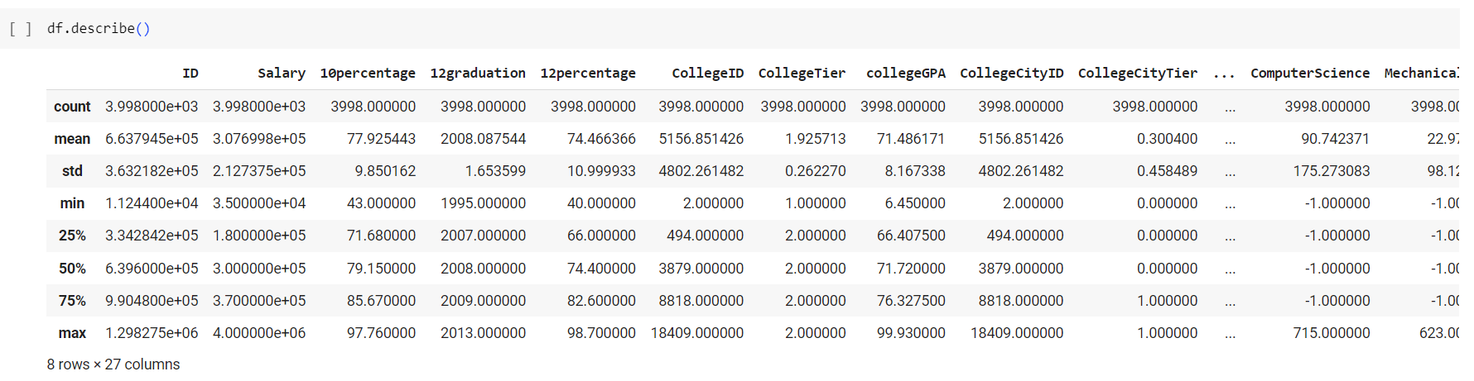
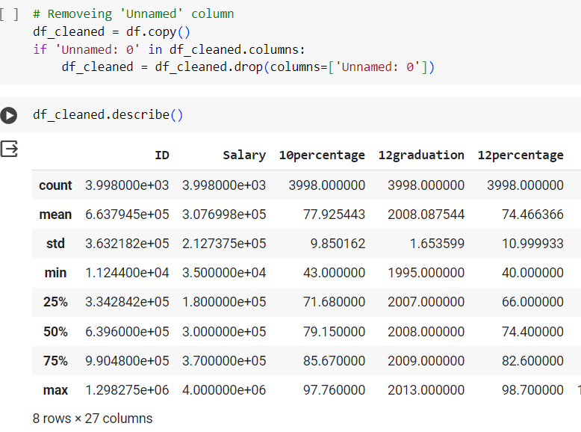
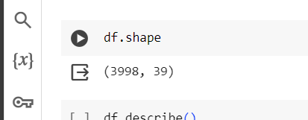
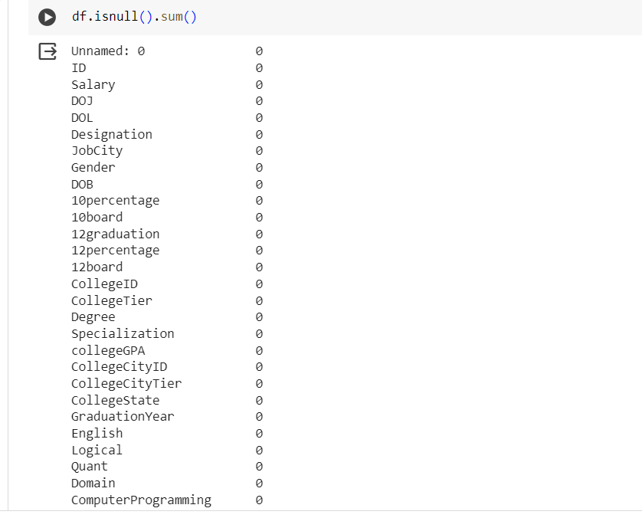
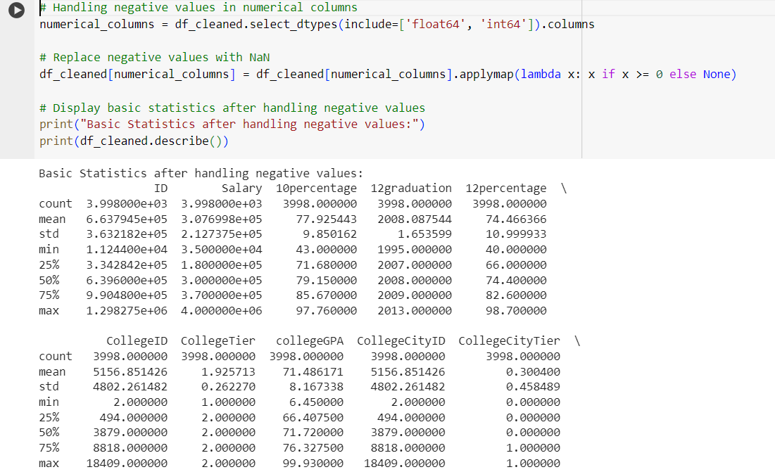
Exploratory Data Analysis
Data Manipulation
Data Cleaning
Describe
Shape
Checking for null values
Removing unnamed Column
Removing Null Values

Slide 5
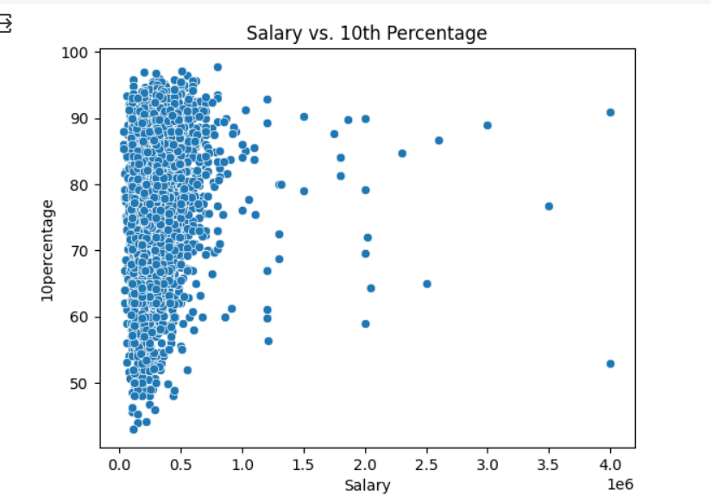
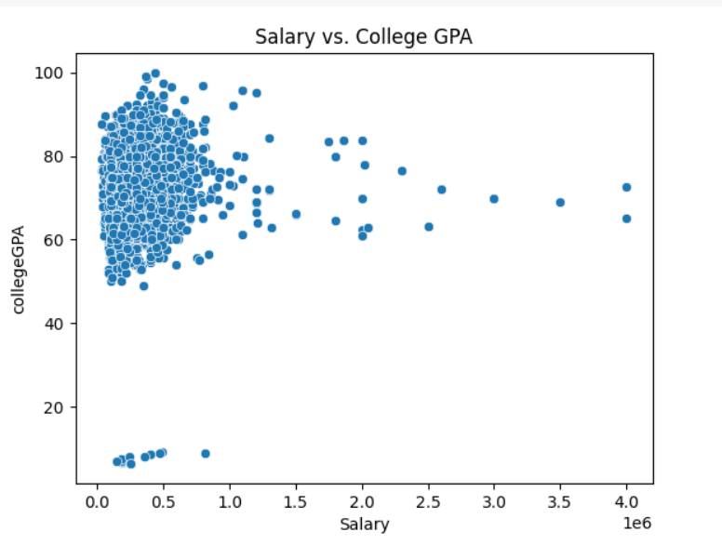
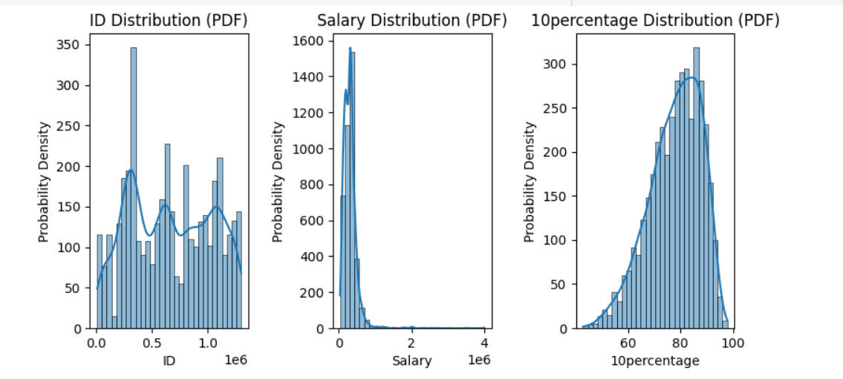
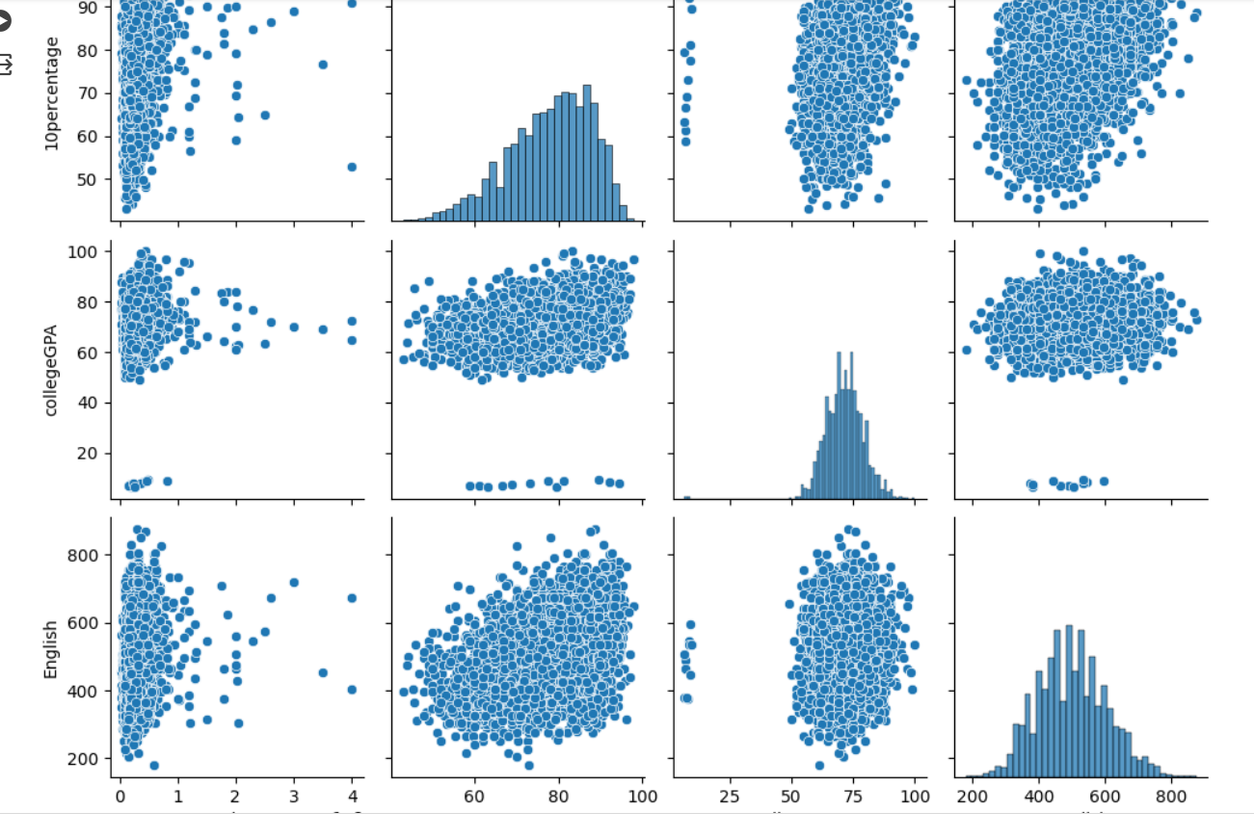
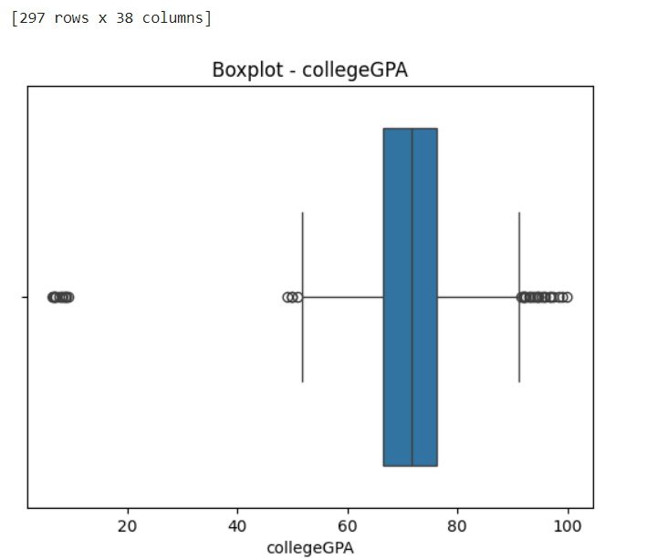
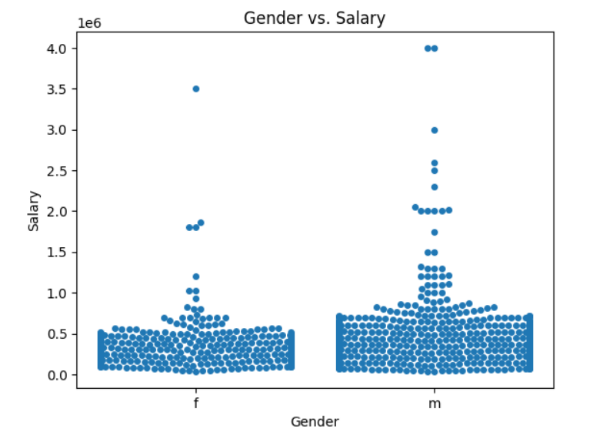
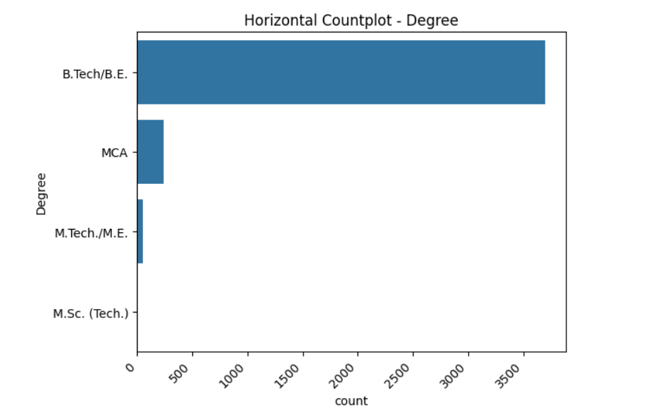
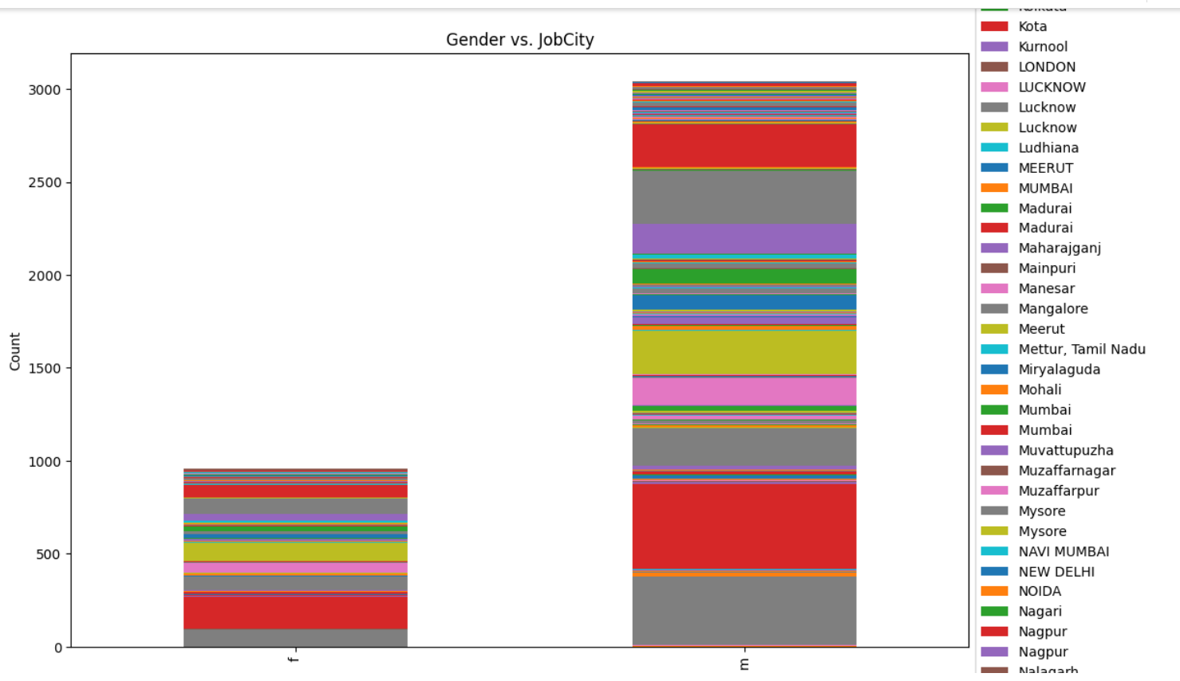
Univariate Analysis
Bivariate Analysis
PDF Graph
Box Plot
Count Plot
Scatter Plot
Pair Plot
Swarm Plot
Stacked bar plot

Slide 6
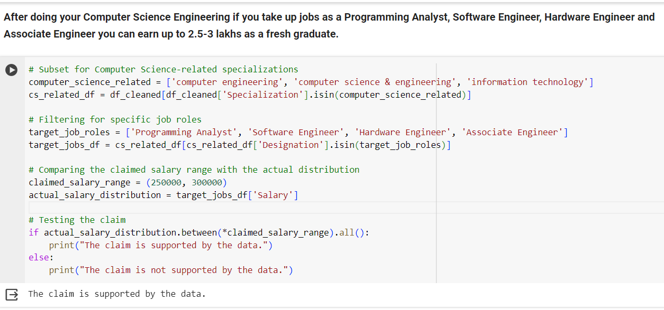
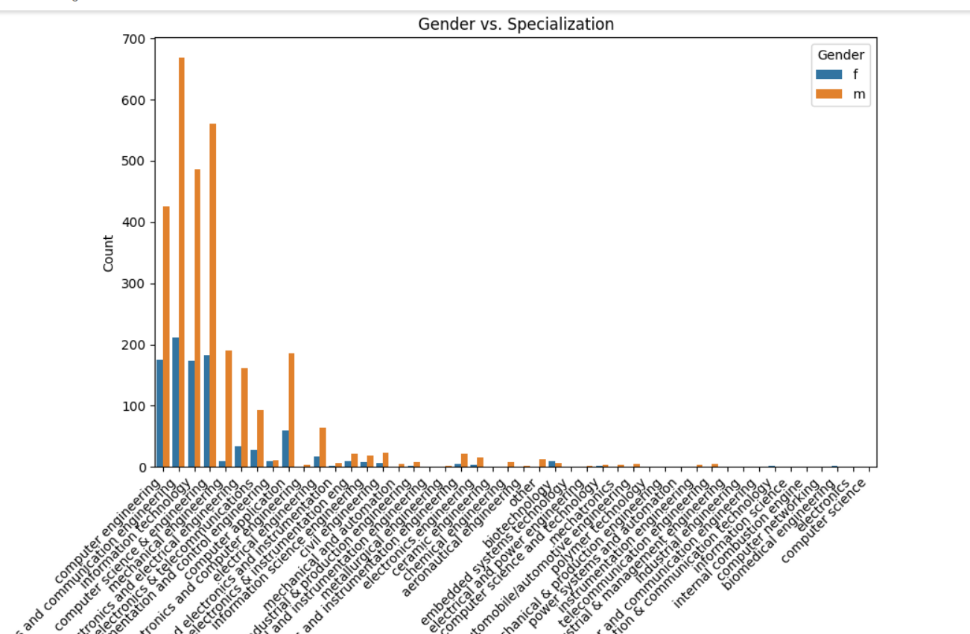
Key Business Questions
Earning 2.5-3 lakhs as a fresh graduate in CSE
Relationship between Gender and Specialization
From the above Gender vs specialization we can see that Gender specialization are related.
From the above we can see that the claim is supported by the data

Slide 7
Conclusion
This data analysis project was initiated by importing and exploring a dataset detailing graduate information. Through univariate analyses encompassing PDFs, histograms, and boxplots, we gained insights into numerical and categorical data distributions, identifying outliers along the way. Bivariate analyses, including scatter plots and bar plots, unearthed relationships between variables and illuminated patterns influenced by gender. In addressing a claim from a Times of India article, the data validated that graduates in specific Computer Science Engineering roles could indeed earn up to 2.5-3 lakhs as freshers. Furthermore, the project unveiled a substantial correlation between gender and specialization preferences. These compelling findings not only inform decision-making but also raise intriguing questions for future research endeavors.

Slide 8

THANK YOU

